Slide 1
Solar tracker using arduino
SUBMITTED BY-
Abhishek M
Avinash M J
Ayush Garg
Jay Dev Rai M

Slide 2
AIM OF PROJECT
Usually fixed solar panels cannot absorb entire sunlight throughout the day time so this system helps the solar panel to rotate such that it faces the sun throughout the day which results in maximum usage and productivity of the solar panels to produce electricity
Our project is based on Arduino Uno and LDR, we placed LDR on both the ends of the solar panel and when the light falls on either of the LDR the panel turns towards that side with the help servo motor and the program stored in Arduino board

Slide 3
COMPONENTS USED
Servo Motor (sg90)
Solar panel
Arduino Uno
LDR’s X 2 (Light Dependent Resistor)
10K resistors X 2
Battery (6 to 12V)
Bread Board
Connecting Wires

Slide 4
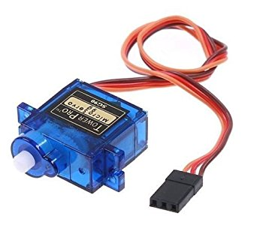
SERVO MOTORS-
A servomotor is a rotary actuator or linear actuator that allows for precise control of angular or linear position, velocity and acceleration. It consists of a suitable motor coupled to a sensor for position feedback. It also requires a relatively sophisticated controller, often a dedicated module designed specifically for use with servomotors.
They are most commonly used in robotics.

Slide 5
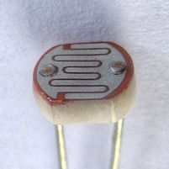
LDR-
A photoresistor (or light-dependent resistor, LDR, or photo-conductive cell) is a light-controlled variable resistor. The resistance of a photoresistor decreases with increasing incident light intensity; in other words, it exhibits photoconductivity. A photoresistor can be applied in light-sensitive detector circuits, and light-activated and dark-activated switching circuits

Slide 6
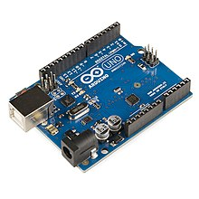
ARDUINO UNO
The Arduino UNO is a widely used open-source microcontroller board based on the ATmega328P microcontroller and developed by Arduino.cc. The board is equipped with sets of digital and analog input/output (I/O) pins that may be interfaced to various expansion boards (shields) and other circuits. The board features 14 Digital pins and 6 Analog pins. It is programmable with the Arduino IDE(Integrated Development Environment) via a type B USB cable. It can be powered by a USB cable or by an external 9 volt battery, though it accepts voltages between 7 and 20 volts

Slide 7

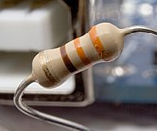
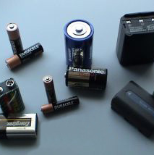
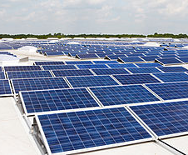
SOLAR PANEL
Photovoltaic solar panels absorb sunlight as a source of energy to generate electricity.
RESISTORS
A resistor is a passive two-terminal electrical component that implements electrical resistance as a circuit element
BATTERY
power source(6v – 12v)

Slide 8
How it Works
LDR’s are working as light detector. LDR (Light Dependent Resistor) also known as photo resistor is the light sensitive device. Its resistance decrease when the light falls on it and that’s why it is frequently used in Dark or Light Detector Circuit.
The two LDR’s are placed at the two sides of solar panel and the Servo Motors is used to rotate the solar panel. The servo will move the solar panel towards the LDR whose resistance will be low, mean towards the LDR on which light is falling, that way it will keep following the light. And if there is same amount of light falling on both the LDR, then servo will not rotate. The servo will try to move the solar panel in the position where both LDR’s will have the same resistance means where same amount of light will fall on both the resistors and if resistance of one of the LDR will change then it rotates towards lower resistance LDR.

Slide 9
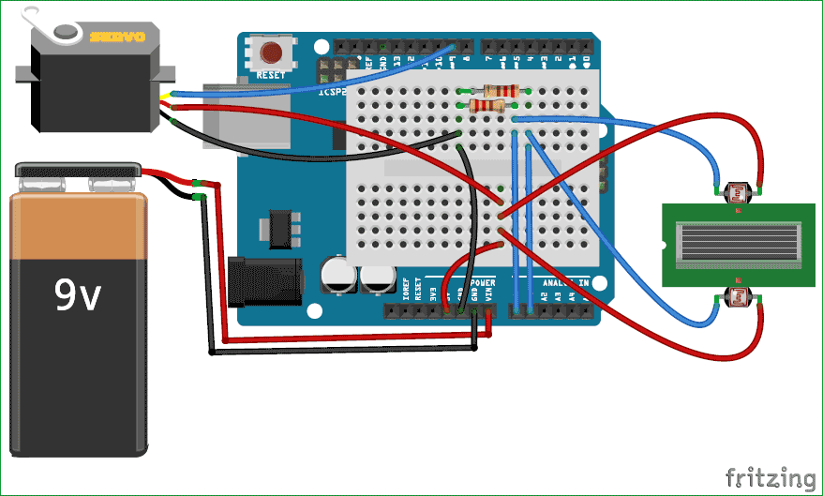
Circuit diagram

Slide 10
explanation
In this Arduino Solar Panel Tracker, Arduino is powered by the 9V battery and all the other parts are powered by the Arduino. Arduino recommended input voltage is from 7 to 12 volts but you can power it within the range of 6 to 20 volts which is the limit. Try to power it within the recommended input voltage. So connect the positive wire of the battery to the Vin of the Arduino and the negative wire of the battery to the ground of the Arduino.
Next connect the servo to arduino. Connect the positive wire of the servo to the 5V of Arduino and ground wire to the ground of the Arduino and then connect the signal wire of Servo to the digital pin 9 of Arduino. The servo will help in moving the solar panel.

Slide 11
Now connect the LDRs to the Arduino. Connect one end of the LDR to the one end of the 10k resistor and also connect this end to the A0 of the Arduino and connect the other end of that resistor to the ground and connect the other end of LDR to the 5V. Similarly, connect the one end of second LDR to the one end of other 10k resistor and also connect that end to the A1 of Arduino and connect the other end of that resistor to ground and connect the other end of LDR to 5V of Arduino.

Slide 12
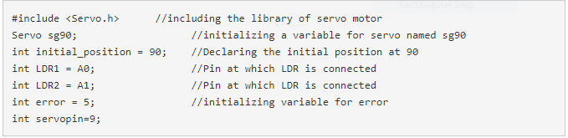
Code explaination
First of all, we will include the library for servo motor. Then we will initialize the variable for the initial position of the servo motor. After that, we will initialize the variables to read from the LDR sensors and Servo.

Slide 13
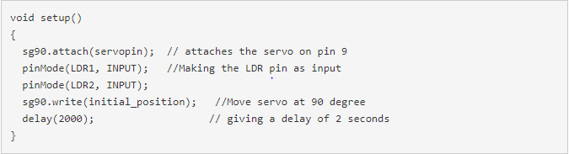
sg90.atach(servopin) command will read Servo from the pin 9 of Arduino. Next we set the LDR pins as input pins so that we can read the values from the sensors and move the solar panel according to that. Then we set the servo motor at 90 degree which is the initial position for the servo.

Slide 14
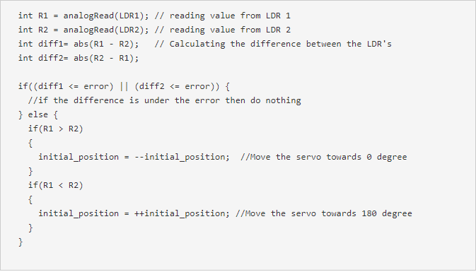
Then we will read the values from the LDRs and will save in R1 and R2. Then we will take the difference between the two LDRs to move the servo accordingly. If the difference between them will be zero that it means that same amount of light is falling on both the LDR’s so the solar panel will not move. We have used a variable named error and its value is 5, the use of this variable is that if the difference between the two LDRs will be under 5 then the servo will not move. If we will not do this then the servo will keep on rotating. And if the difference is greater than error value (5) then servo will move the solar panel in the direction of the LDR, on which light is falling

Slide 15
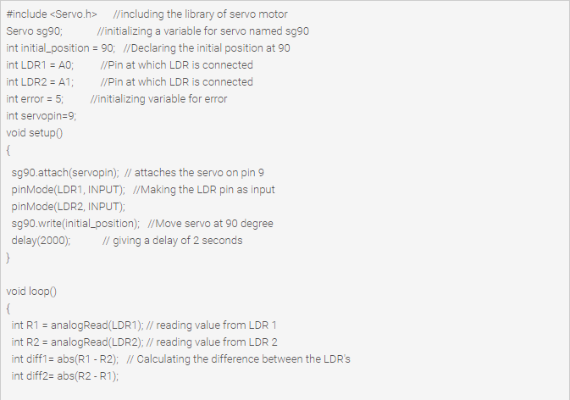
Final code

Slide 16
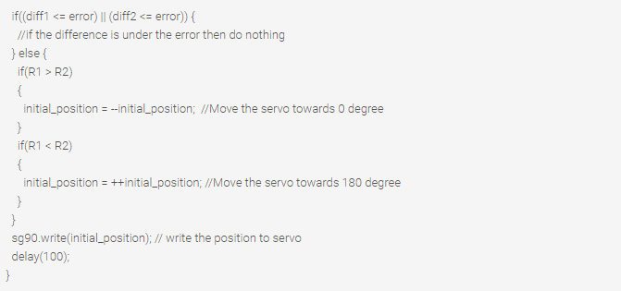

Slide 17
conclusion
After executing this project we learned the basics of arduino and its uses in various electronic devices used in our daily life. We even learned to program the arduino to use it as per our project requires. We learned about various electronic components such as LDR and Servo motor

Slide 18
Thank you

